Slide 1


Nevada Homeless Alliance Annual Impact Report 2024
Dr. Catrina
Executive Director

Slide 2
With Gratitude
To our funders, partners, volunteers, and advocates—
Thank you for making a difference in 2024.
Together, we are building a future where everyone has a place to call home.

Slide 3
Our Mission & Vision
Mission:
To advance collaborative strategies to end homelessness in Southern Nevada through advocacy, public awareness, education, and coordination of services.
Vision:
To end homelessness in Southern Nevada.

Slide 4
2024 Impact Summary By the Numbers
In 2024, NHA served 5,339 individuals across Southern Nevada through various outreach and support programs designed to meet people where they are and connect them with life-changing resources.
36 Pop-Up Events
13 Family Connects
657 Housing Services
1,203 Medical Services
1,165 Recovery Services
108 IDs
75 Haircuts

Slide 5
2024 Programs
Pop Up Connect Events=Bringing critical services directly to the streets (Ongoing)
Family Connect Pop Ups=Meeting family needs with targeted, wraparound support (Ongoing)
People with Lived Experience=Centering lived voices in all systems change work= (Ongoing)
Homeless Diversion and Barrier Busting Program=Removing obstacles like ID loss, financial assistance (rent, deposits, auto repair, food, etc.)
SNHD Vaccine Pods=Making vaccines and healthcare accessible to the most vulnerable

Slide 6
2024 OTHER
Homeless Service Provider Training
2024 NV Statewide Conference on Addressing Homelessness: LEVEL UP: Policy, Practice, Partnerships
31st Annual Homeless Candlelight Vigil: "Celebration of Hope
2024 NAEH Conference on Ending Homelessness: Along with Lived X Team Members and other computer partners- Capitol Hill Day Captain!!
2024 Lived Experience Leadership Conference

Slide 7
Pop-Up Project Homeless Connect Events
Held 36 times in 2024, our mobile outreach events bring vital resources directly to those in need, offering housing assistance, health services, employment help, and more in a one-stop model.
Family Connect- in partnership with CCSD
Through 13 events in 2024, Family Connect provided tailored support to families in crisis, including legal aid, Medicaid enrollment, youth services, and housing assessments.

Slide 8
Project Homeless Connect Outcomes
Services Provided:
657 Housing Navigation
1,203 Medical
1,165 Recovery/SU Services
108 ID Recovery
60+ Birth Certificates
473 Mental Health
393 Employment

Slide 9
Lived Experience Leadership
We supported advisory boards in Clark and Washoe counties made up of individuals with lived experience of homelessness, justice involvement, mental health or substance use, domestic violence, etc.. helping to ensure inclusive, informed decision-making across systems.
Washoe County LEAB
Southern Nevada Lived X Consultants (TEAM)
Now includes two FTE Lived Experience Specialists!
9 Independent Contractors
Advocacy, scoring and ranking, training, and community education

Slide 10
Homeless Diversion and Barrier Busting Program
Launched in 2022, this ARPA-funded initiative removed barriers to housing by providing essential documents (IDs, birth certificates), emergency financial assistance, and referrals to critical services.
100% under 50% AMI
2,700+ served since 2022
1,800+ ID recoveries
850 Birth Certificate assistances
Financial help for housing, employment, transportation
Re-Entry @ NDOC

Slide 11
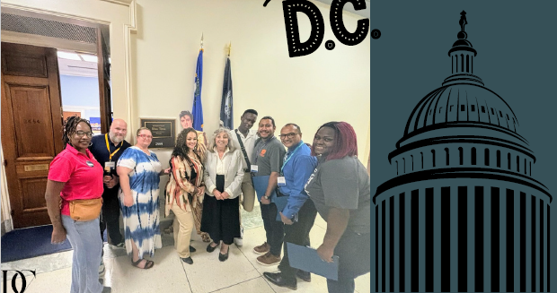

NAEH Capitol Hill Day

Slide 12




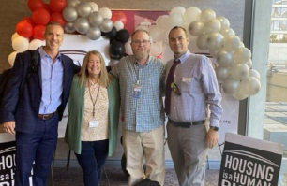
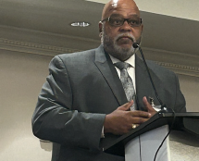

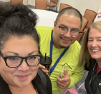
2024 NV Statewide Conference on Addressing Homelessness

Slide 13

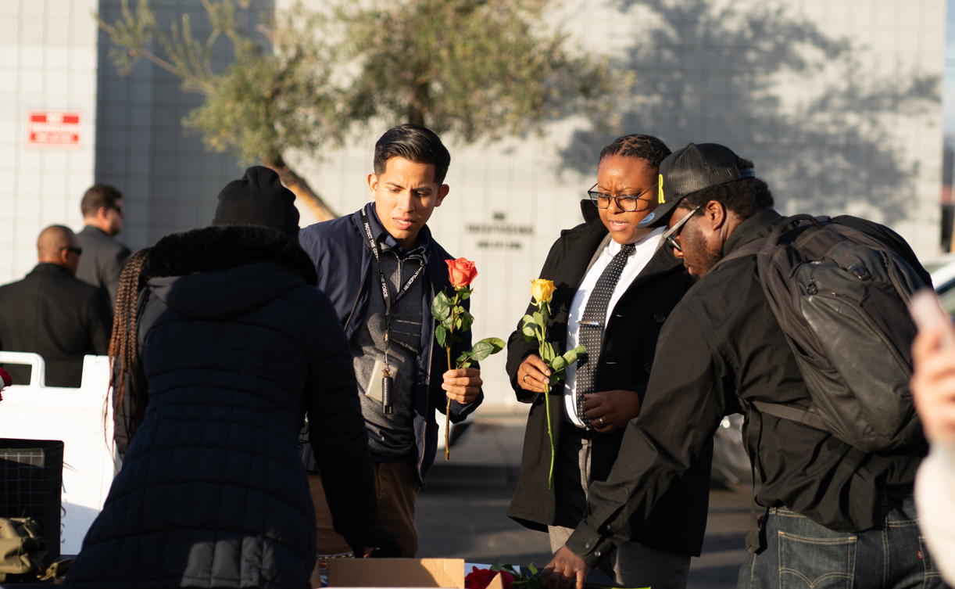



31st Annual Homeless Candlelight Vigil: "Celebration of Hope"

Slide 14
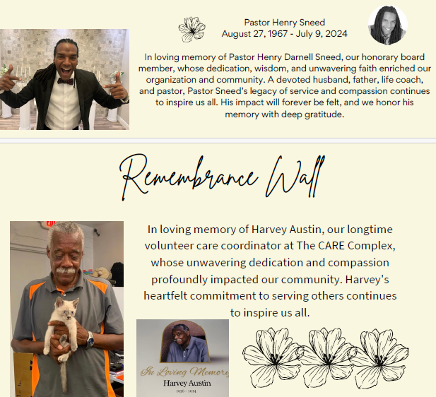

Vigil.. Continued

Slide 15
Intersection between incarceration and homelessness
National research suggests that up to 15% of incarcerated people experience homelessness in the year before admission to prison.
City- and state-level studies of homeless shelters find that many formerly incarcerated people rely on shelters, both immediately after their release and over the long term.
People who have been to prison just once experience homelessness at a rate nearly 7 times higher than the general public.
People who have been incarcerated more than once have rates 13 times higher than the general public.
Couloutte, L. (2018). Nowhere to go: Homelessness among formerly incarcerated people. Prison Policy Initiative. https://www.prisonpolicy.org/reports/housing.html#insecurity

Slide 16

The buzz….
“People don’t want to share where they are going when they expire their sentence….”
“They are no longer NDOC responsibility”
“There are laws in place that stipulate that we have to provide them with gate money, medications, and drop them off if that is part of their release plan”

Slide 17
NEVADA’S RE-ENTRY VISION (2021)
Nevada’s Re-entry Vision is dedicated to reducing the rate of offenders returning to incarceration by utilizing collaborative interagency partnerships and nationwide best practices for re-entry programming. Success for an offender is defined as: having stable housing and employment, effective treatment, positive personal relationships, family support and appropriate supervision that will enable productive and law-abiding lives. Nevada believes it has an economic and moral imperative to support offenders recently released from custody to regain entry into the community.

Slide 18
There is a link between poverty and incarceration nationwide.
What does that look like in Nevada?
There is no data about recidivism rates specifically for poor and homeless Nevadans because the states incarceration data isn’t run against the homeless services data OR data is simply not collected.
Returning citizens:
Face the same challenges that lead to homelessness among the general population.
Face unique barriers to housing and employment associated with their criminal justice system and involvement
There is a lack of ownership of the problem among government agencies and community organizations

Slide 19
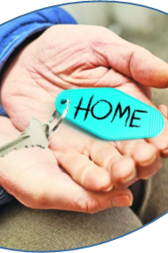
Communication and Collaboration
It is critical that local leaders, local, state, non-profit agencies, citizens, and service providers understand the connection between homelessness and the criminal justice system to develop communities and ensure everyone has access to safe and stable housing.
NHA tirelessly does this work!
Notes:
After you’ve done your research, it’s time to put your presentation together. The first step in the process is to introduce the topic. This is a great time to connect your topic to something that your audience can relate. In other words, why should they listen to all the information you will be sharing in your research presentation? What is in it for them? You may also want to include a graphic or image to grab their attention.
Feel free to duplicate this slide by right-clicking on this slide in the slides pane to the left and select Duplicate Slide.
The next step in your presentation is to state your claim or topic clearly. Your teacher may even call this your thesis. As you state your thesis, you may find that this layout is not the best layout for your claim or topic. You can change the layout by clicking the drop-down menu next to the Layout in the Slides menu section. You can choose Two Content, Comparison, or Picture with Caption. Note: A different layout might change the look of the icons on this page.
You will also want to state your facts. You have done the research now share some of the interesting facts with your audience. Facts do not have to be boring; you can communicate facts in a variety of ways by going to the Insert Tab. In the Insert tab you can:
Insert pictures from your computer or online.
Add a chart
Create some SmartArt
Insert a variety of icons to help your facts come to life. Note: You can change the color of the icons by selecting the icon and then click on the Format tab and then Graphics Fill. From there, you will choose a color from the list or choose More Fill Colors to give you more options.
Since this research presentation is a result of your hard work and searching, you want to make sure you support the claims or points in your presentation with facts from your research findings. Make sure you give the author proper credit for helping you share your ideas. If one of your sources has a video that is relevant to your topic, you can add the video as added support. Keep in mind the length of the video and the amount of time you have for your presentation. For a 5 minute speech, the video should be no longer than 30 seconds.
Questions to consider:
How will you state the author of the source?
Will you need to cite the source on the slide?
What are some ways you can engage your audience so they feel like they are a part of the presentation? Some ideas to consider is by taking a quick poll like: by a show of hands, how many of you think school uniforms are a way to cut down on bullying? Another suggestion is to have them hold up a certain number of fingers to see if they agree or disagree. Finally, you can share a story that the audience can relate to that makes them laugh.
After all the applause, your audience may have some questions. Be prepared to answer some of their questions by making a list of questions you think they might ask. You may also want to share the presentation with them by providing the link to your presentation, if they want more information.

Slide 20

Suggestions
Create a re-entry task force/working group;
Add ‘housing status’ as a data point to be collected at prison entry and exit- Accomplished with AB32
Synthesize data to determine how homelessness does/does not impact recidivism rates;
Strategize community plans to ensure returning citizens are:
Informed about housing options
Screened prior to exit, if appropriate
Ensure returning citizen are provided with housing search, placement and financial assistance as well as case management upon exit from prison or while on parole, if appropriate
Notes:
Now, that you have narrowed your topic, you will want to organize your research in a structure that works. There are some common organizational patterns based on the kind of research you are doing.
Organizational Structures:
Cause and Effect- this kind of structure is great for explaining the causes and effects of a topic
Compare and Contrast- in this pattern you highlight the similarities and differences of the topic
Explain process- this structure is great for outlining a series of steps to follow;
Definition- if you want to make sure your audience understands what something is using illustrations, meanings, clarifying misconceptions, you may want to use this structure
Classification- a common organizational structure is grouping like topics or facts from the research together. For instance, in the internet safety about social media apps, you may organize the research where you look at each social media app one at a time

Slide 21

2025 … and Looking Ahead
NHA App Launch: Improving access to services via mobile tech
Ongoing Pop-Up Events….. Monthly Family Connect Pop Ups
Employment Connect
Quarterly Medical Connects starting in Q3
Monthly Youth Connect starting in Q3
NEW!!!!
Pet Deposits and Fees, Silver Summit CIP Re-Entry Program launch, Flexible Funding to assist individuals obtain and maintain permanent housing.
Homeless Service Provider Training- CEUs approved by BOE/SW and NCB
Pssttttt- We have a NEW HOME!!!

Slide 22
2025 … and Looking Ahead
2025 Statewide Conference: Mission Possible: Policy, Practice, Partnerships (September 2025)
YHDP Guided Home Youth Peer Navigation (October 2025)
Biannual 2025 Project Homeless Connect: over 150 partners providing on-the-spot resources (November 2025)
Annual Candlelight Vigil: Honoring lives lost to homelessness (December 2025)

Slide 23
Thank you
director@nevadahomelessalliance.org
www.nevadahomelessalliance.org
Thank you for making a difference in 2024.
Together, we are building a future where everyone has a place to call home.

